Slide 1
Database Queries

Slide 2
Queries
Queries are questions used to retrieve information from a database.
Contain criteria to specify the records and fields to be included in the query results.
Can contain wild cards or logical operators to make more complex queries
    * and ?
    <, >, <=, >=, <>, =, AND, OR, etc…
Named and saved so they can be run again at a later time.

Slide 3
Query Languages
A query language such as SQL (Structured Query Language) provides a set of commands for locating and manipulating data
  LIST ALL FOR STATE = “KY”
  Not user friendly
Query By Example is another query language
  Fill out a form that describes your query
  More friendly

Slide 4
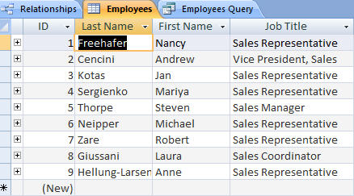
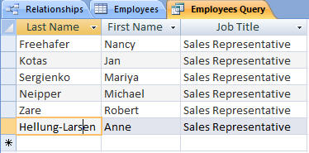
Queries
Dataset resulting from querying table for only employees who are Sales Representatives
Employees table
Queries allow us to ask questions about data
This record set that answers our question is called a dataset
Notes:
4
Queries allow us to ask specific questions about the data and receive a record set back that answers our questions. This returned record set is called a dataset. Simply running a query does not change the actual table data. However, you may alter the data in a dataset and the changes will be reflected in the underlying table.

Slide 5
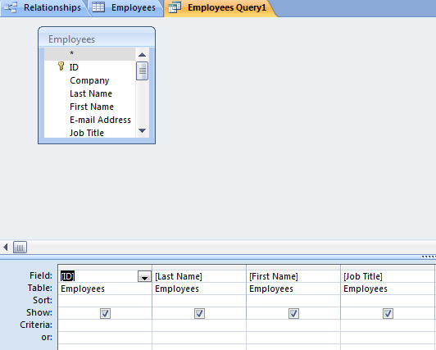
Using Query Design View
Tables pane
Design pane
Query Design grid has two panes – the table pane and the design pane
Striking the F6 key will toggle you between sections
Notes:
5
Query Design view has two panes – the table pane and the design pane. Striking the F6 key will toggle you between panes.

Slide 6
Specifying Criteria in a Select Query
Fields in design grid allow us to specify criteria for the dataset
Field row – displays the field name
Sort row – enables you to sort the dataset
Show row – controls whether or not you see a field in the dataset
Criteria row – determines the records that will be selected for display
Notes:
6
Parts of the Design Grid include:
Field Row – displays the field name
Sort row – enables you to sort the dataset
Show Row – controls whether or not you see a field in the dataset
Criteria row – determines the records that will be selected for display

Slide 7
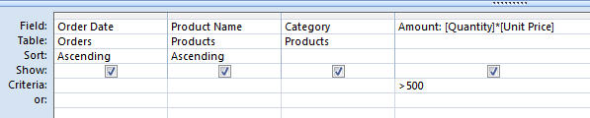
Specifying Criteria – Currency and Operands
Currency amount entered without dollar sign
Greater than (>) operand
Specify criteria with currency
  Without the dollar sign
  With or without the decimal point
Use operands such as:
  Less than and greater than
  Equal to or not equal to
Notes:
7
Specify criteria with currency without the dollar sign and with or without the decimal point. Use operands such as less than, greater than, equal to or not equal to, in order to compare your criteria against data in the specified field.

Slide 8
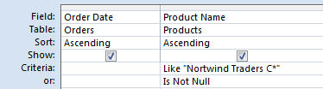
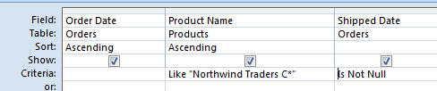
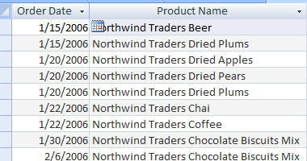
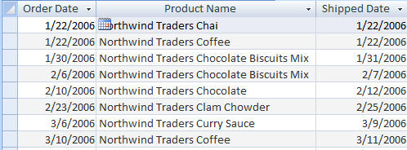
Specifying Criteria – And and Or
Or Criterion and resulting dataset
And criterion and resulting dataset
OR finds records that can match one or more conditions
AND finds records that must match all criteria specified
Notes:
8
Use the OR criterion to find records that can match one or more conditions specified. Use the AND criterion to find records that must match all criteria specified.

Slide 9
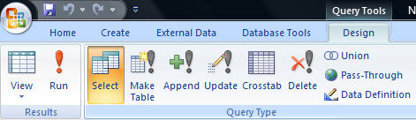
Run a Query
Run command
Running, or executing, a query is done by clicking the Run command
Notes:
9
Running, or executing, a query is done by clicking the Run command located by clicking the Design tab and accessing the Results group.

Slide 10
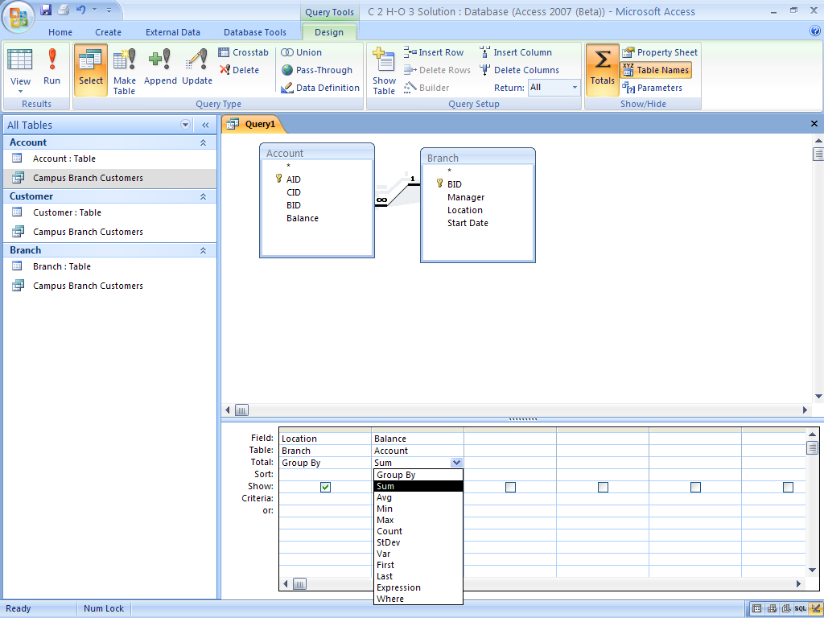
Add a Total Row in a Query
The total row can be added to the design grid by clicking the Totals Icon
Totals Icon
Total row added to the query
Notes:
The total row can be added to the design grid by clicking the Totals Icon.

Slide 11
Calculated Queries
Will find averages, max, min, sum, std
You usually work with one field, not more
  If you use 2 fields, you get multiple answers
Add Totals row to query
Open “Group By” menu
Choose appropriate function
Run query

